Slide 1
Colonies
City
a large town
Colony
a group of people who leave their native country to form in a new land a settlement subject to, or connected with, the parent nation
invariably involves displacement of original inhabitants
Villa
a large country estate
origin of the word ‘village’

Slide 2
Roman Colonies
The Latin League
Latin Rights
Military alliance of Latin cities with Rome
Formalized as the Foedus Cassianum (‘treaty of Cassius’)
Romans and Latins founded joint colonies that became independent members of the League
Commercium
Right to own Roman land, slaves, cattle, and to inherit from Romans
Conubium
Right to intermarry with Roman citizens
Ius migrandi
Right to live in Roman territory

Slide 3
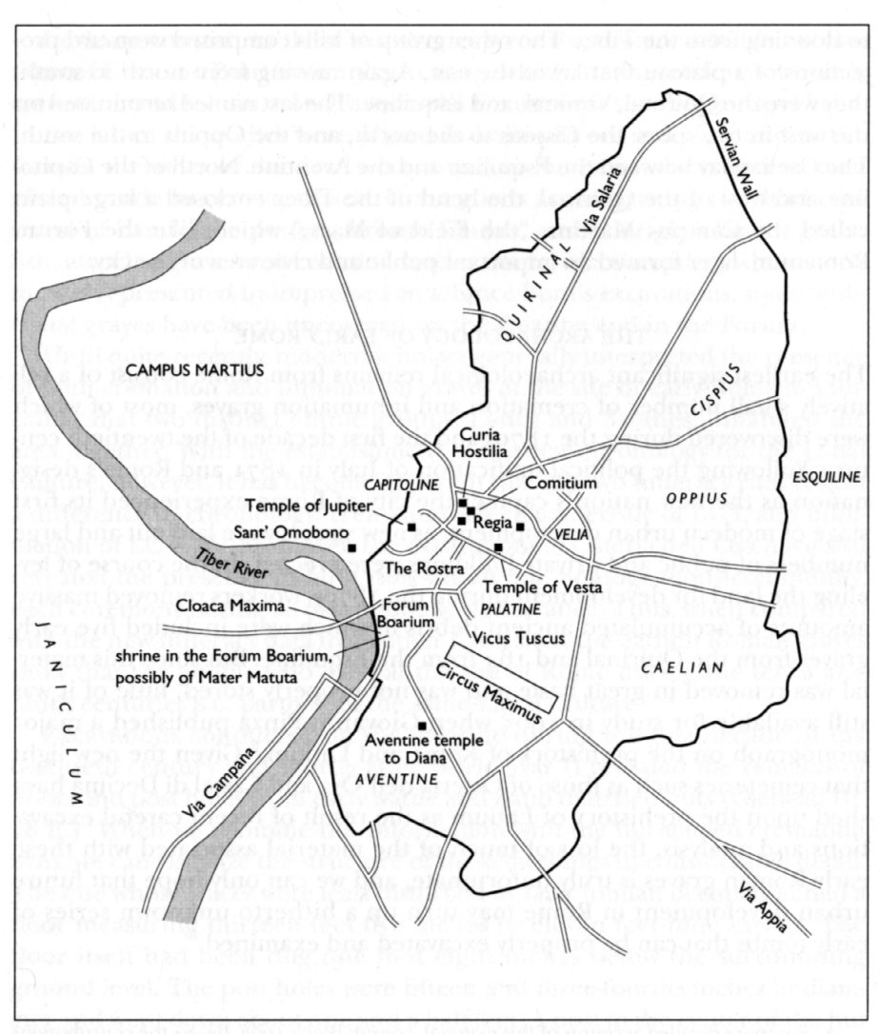
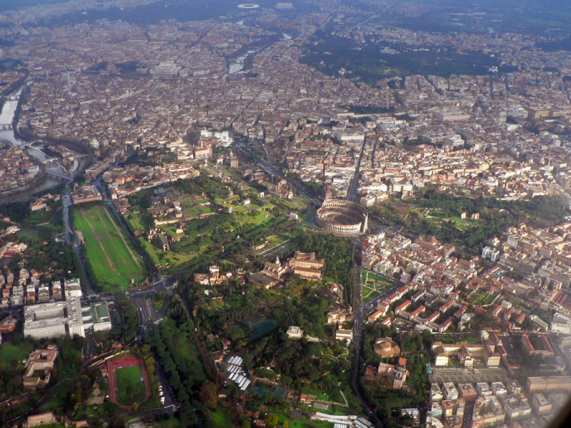
Rome
Rome, 2008

Slide 4
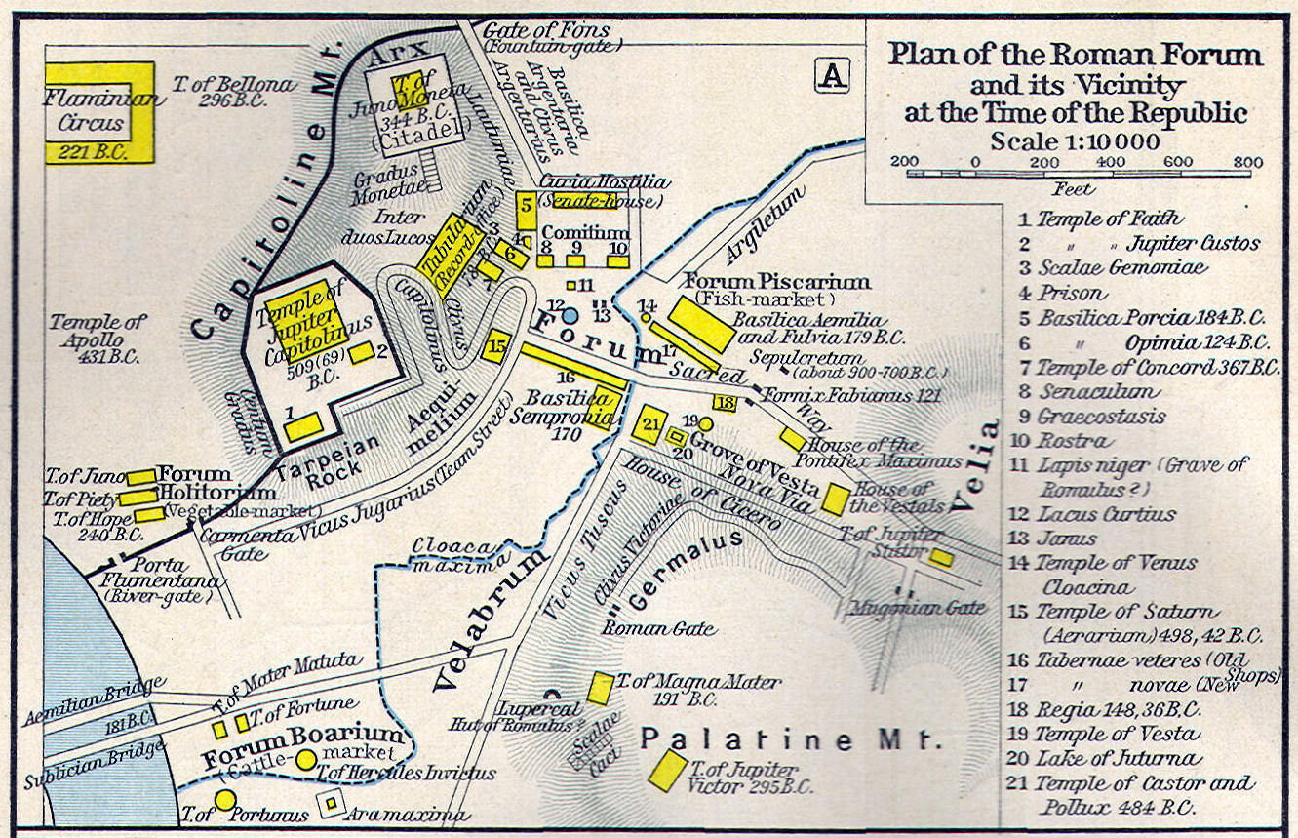
The Forum

Slide 5
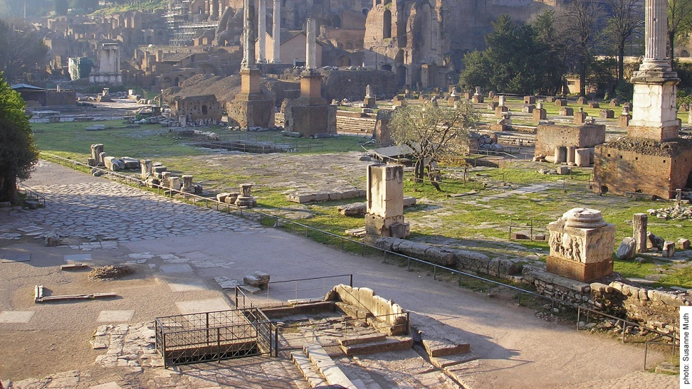
The Forum
Capitoline and Palatine hills
Comitium
Rostra
Curia
Via Sacra
Temple of Jupiter Optimus Maximus
Site of the Comitium in Rome

Slide 6
Roman and Latin Colonies

Slide 7
Centuriation
Process of laying out a grid to distribute land
Typically carried out by a commission appointed by the senate
Decumanus maximus = main east-west street
Kardo maximus = main north-south street
i.e. primary grid axes

Slide 8
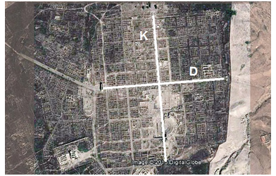
Centuriation

Slide 9
Luna
Roman citizen colony founded c. 177 BCE
Originally comprised of 2000 Roman citizens
Connected to Rome by the Via Aemilia Scauri (built c. 115 BCE)

Slide 10
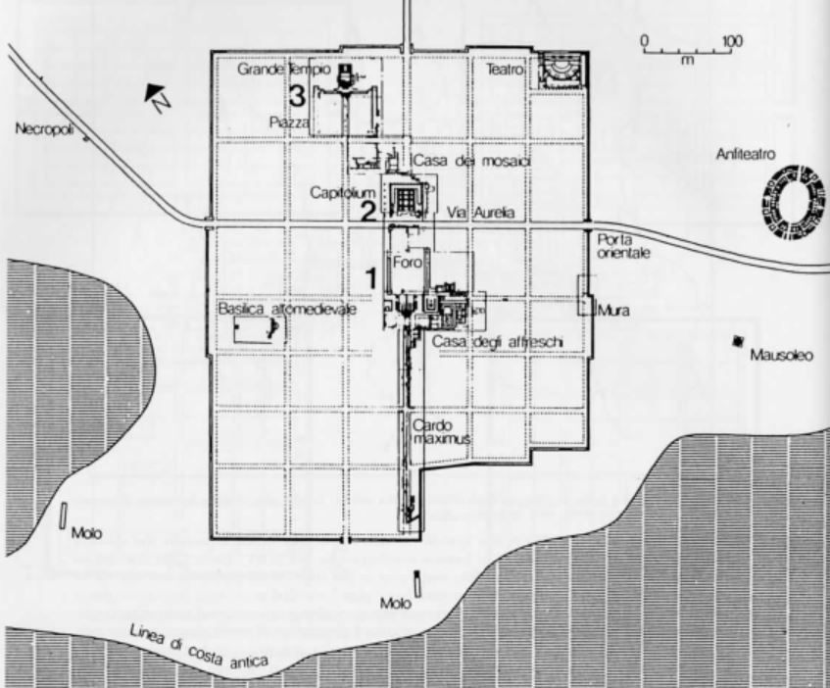
Luna
Forum
Temple of Jupiter Capitolinus

Slide 11
Paestum
Latin colony founded c. 273 BCE
Built on the site of the Greek colony of Poseidonia (which sided with Pyrrhus)

Slide 12
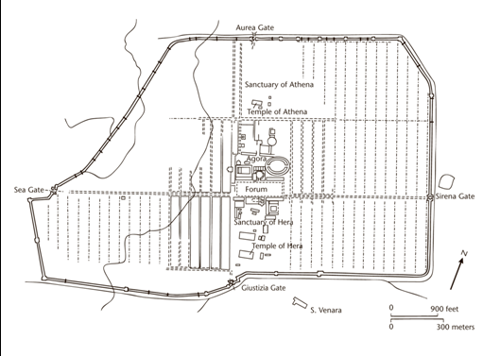
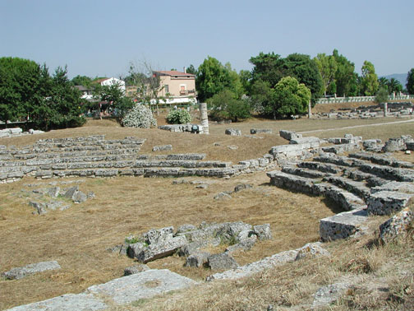
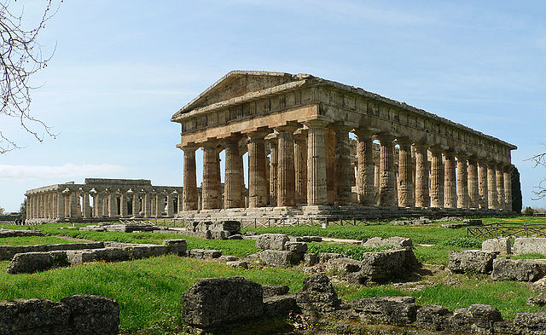
Paestum

Slide 13
Cosa
Latin colony founded c. 273 BCE
Built on a promontory on the Tyrrhenian coast
Nearby Etruscan city of Vulci had revolted in 280 BCE; Cosa built to watch it
Probably originally 2500 families

Slide 14
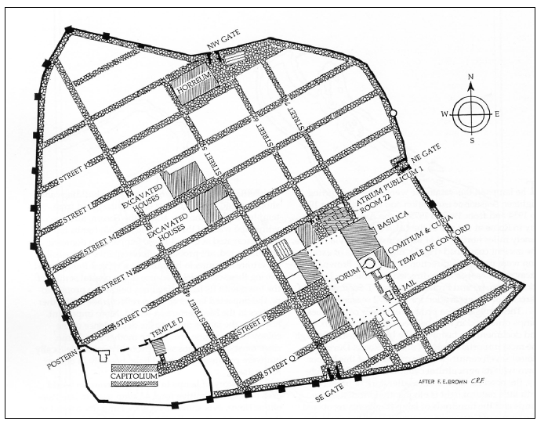
Cosa

Slide 15
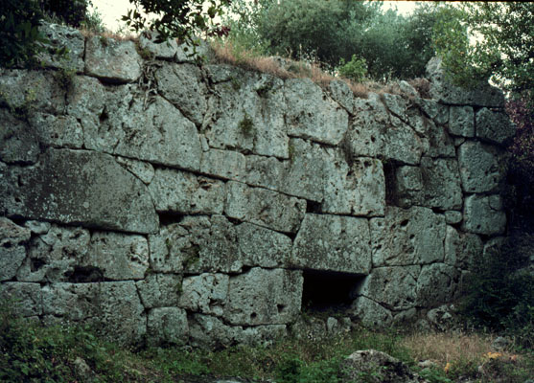
The Walls of Cosa

Slide 16
Cosa

Slide 17
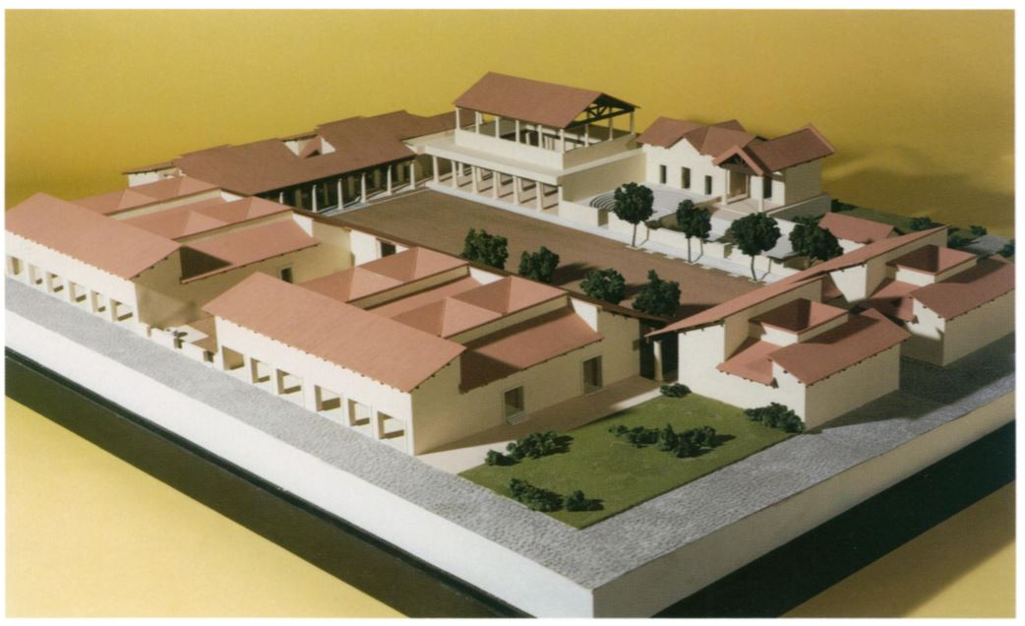
The Forum of Cosa

Slide 18
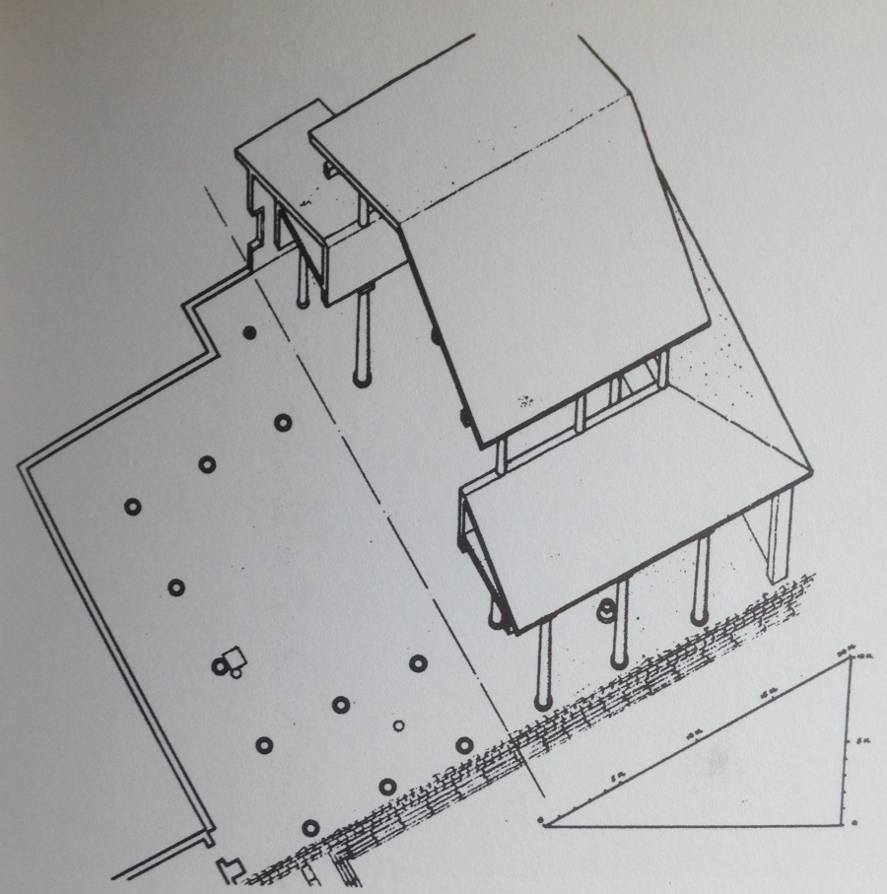
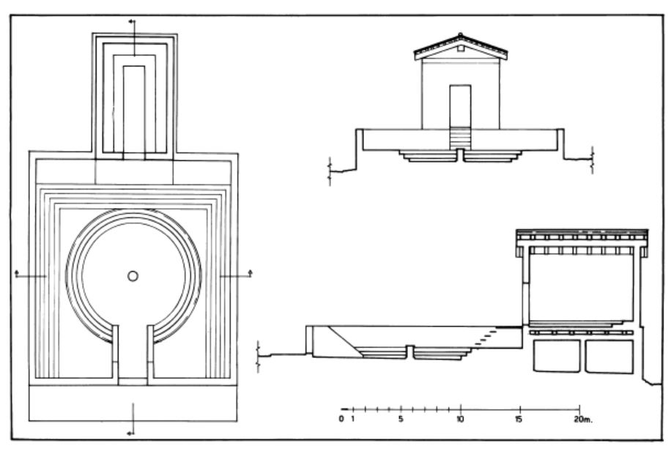
The Forum of Cosa
Comitium
Curia
Basilica

Slide 19
Cosa

Slide 20
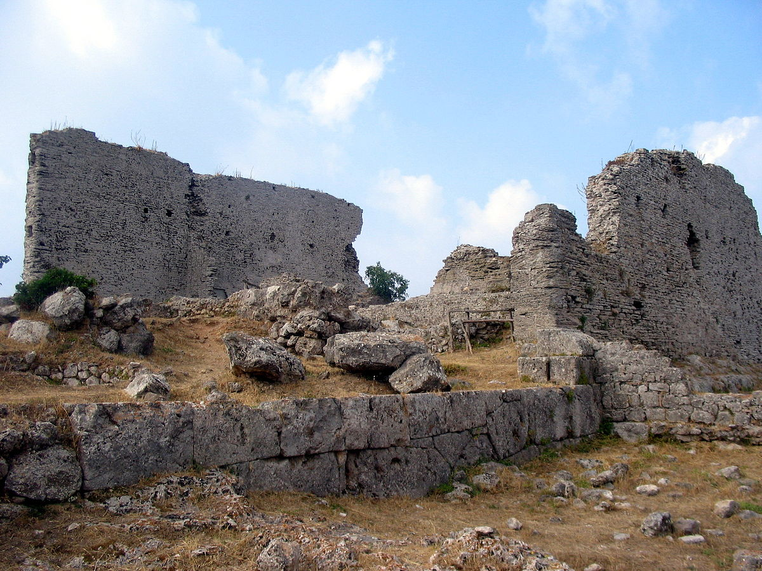
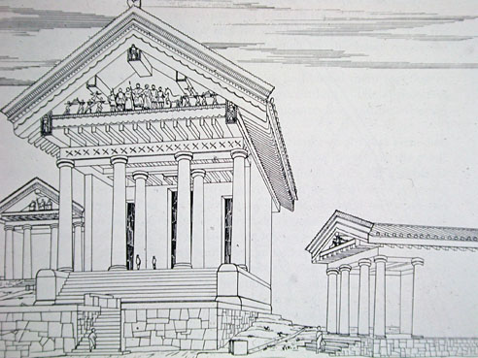
The Cosa Capitolium

Slide 21
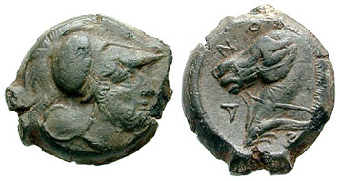
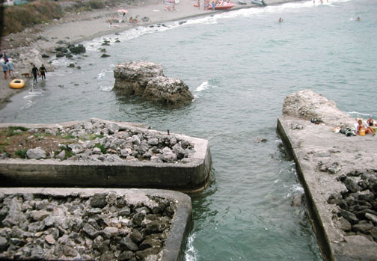
The Port of Cosa
Bronze quartuncia of Cosa, c. 273-250 BCE; obv.: head of Mars facing right; rev.: horse facing left, riding on a dolphin; legend: COZANO

Slide 22
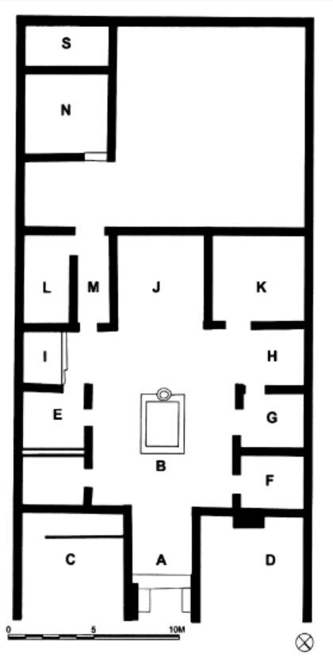
The House of Diana at Cosa
*
Early 2nd cen. BCE
A. Entry hall
B. Atrium
C-D. Tavernae
E-G. Cubicula
H-I. Alae
J. Tablinum
K. Triclinium
L. Kitchen
M. Hallways
N-S. Bath?

Slide 23
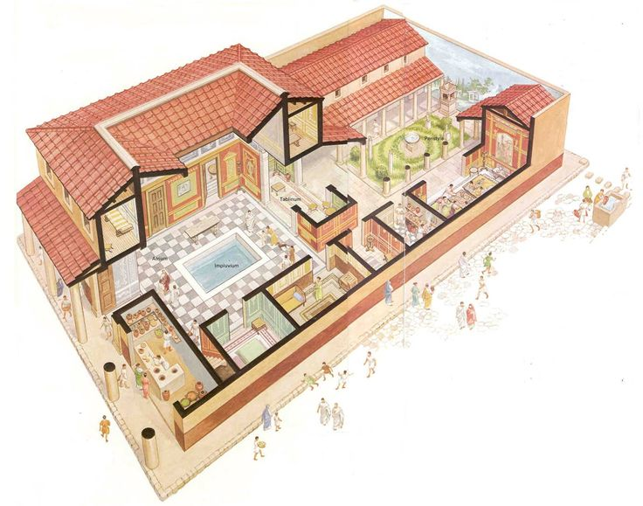
The Roman House
*

Slide 24
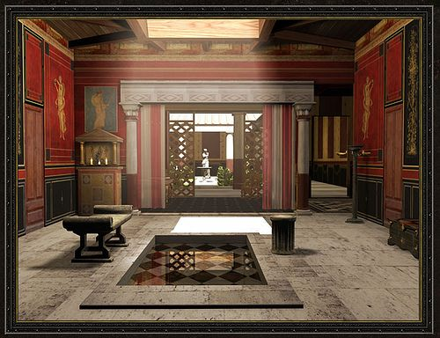
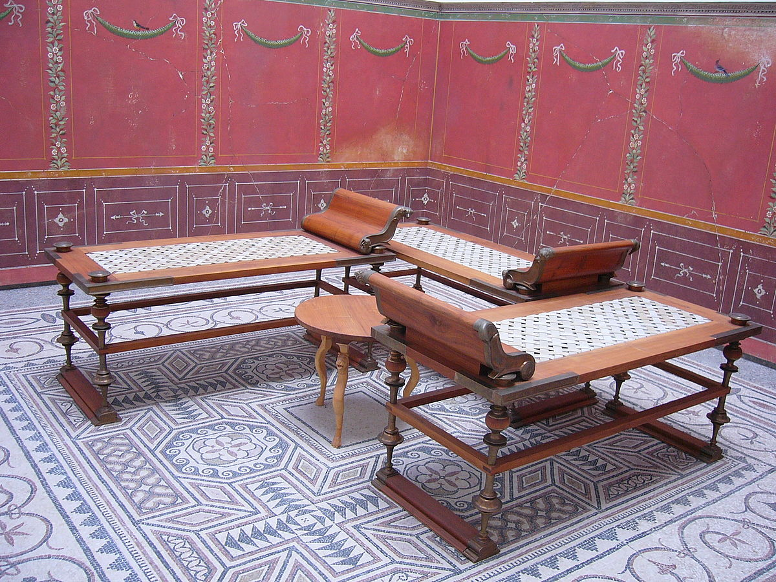
Atrium
Triclinium

Slide 25
Back to Rome

Slide 26
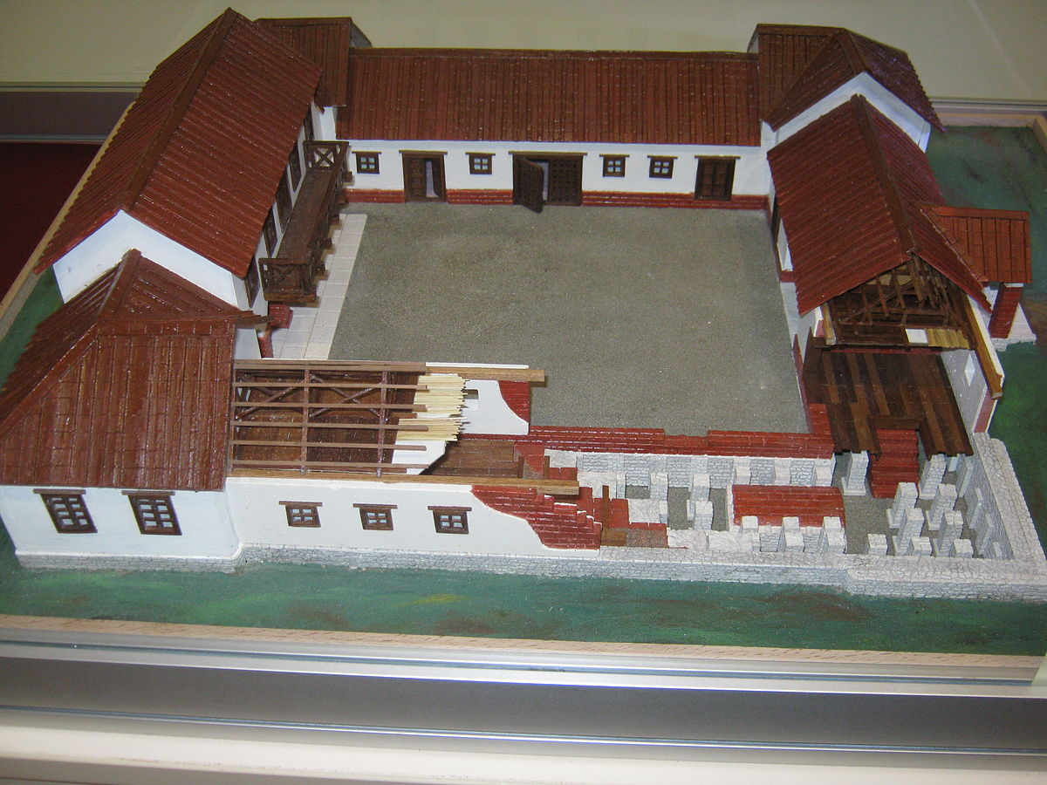
Villas

Slide 27
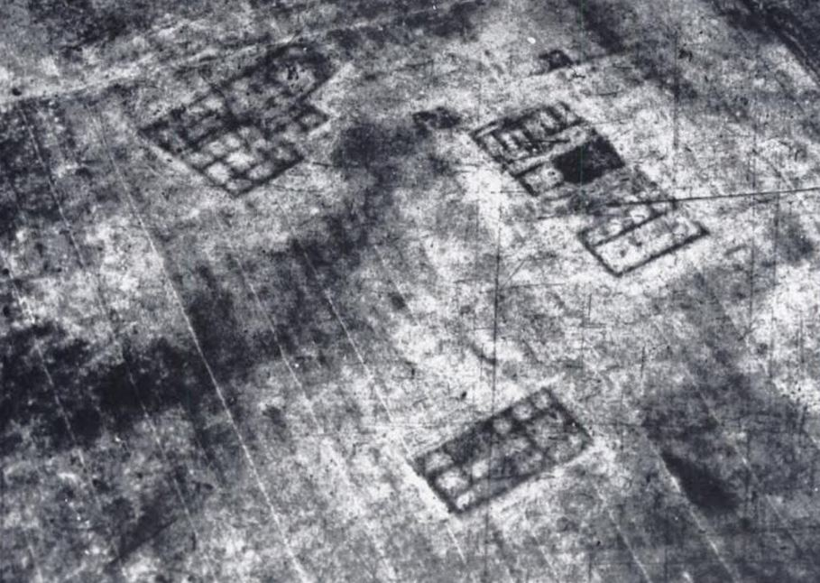
Villas in Apulia

Slide 28
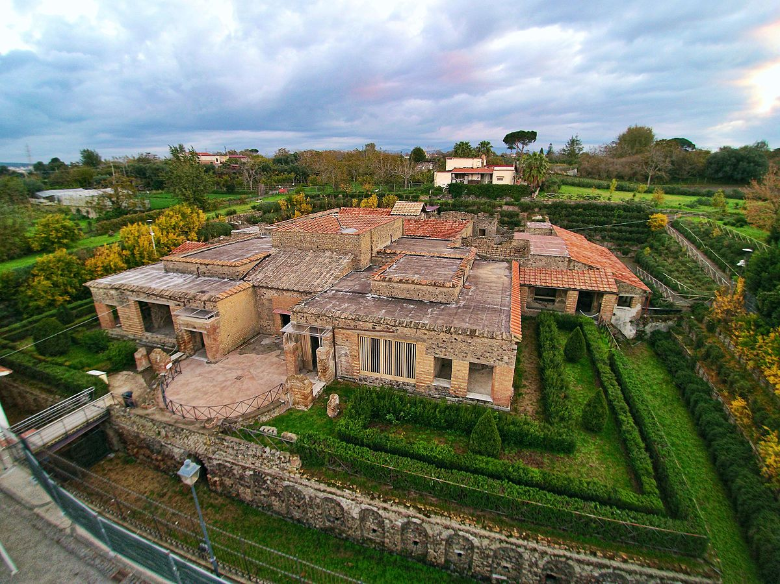
Villa of the Mysteries
*
Villa of the Mysteries, near Pompeii, c. mid 1st cen. BCE

Slide 29
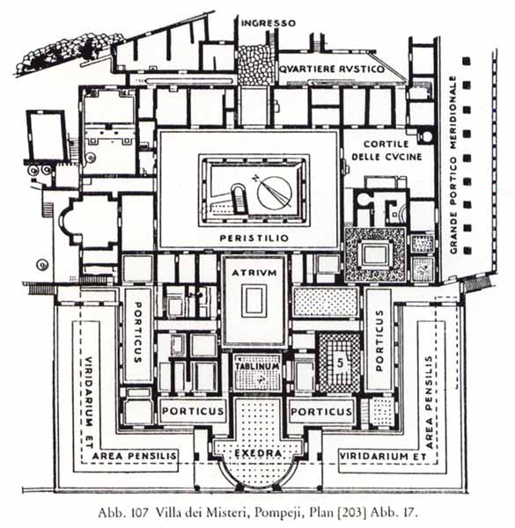

Slide 30
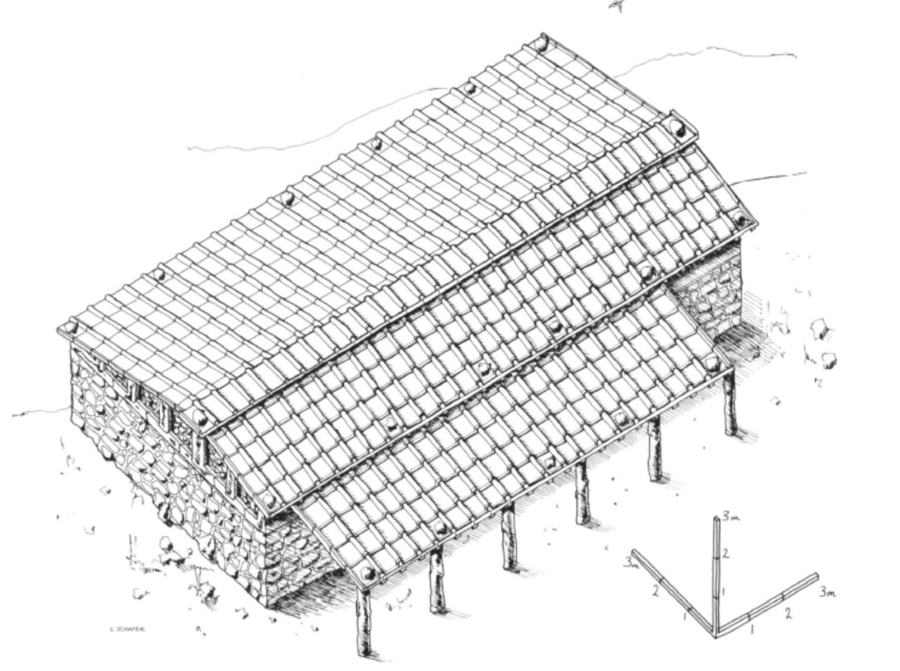
Farms
Reconstruction drawing of an Etruscan farmhouse at Podere Tartuchino, c. 600-400 BCE
“Finally, the simplicity of the building suggests that if farm animals were provided with accommodation, it would have had to be shared with the human occupants.”

Slide 31
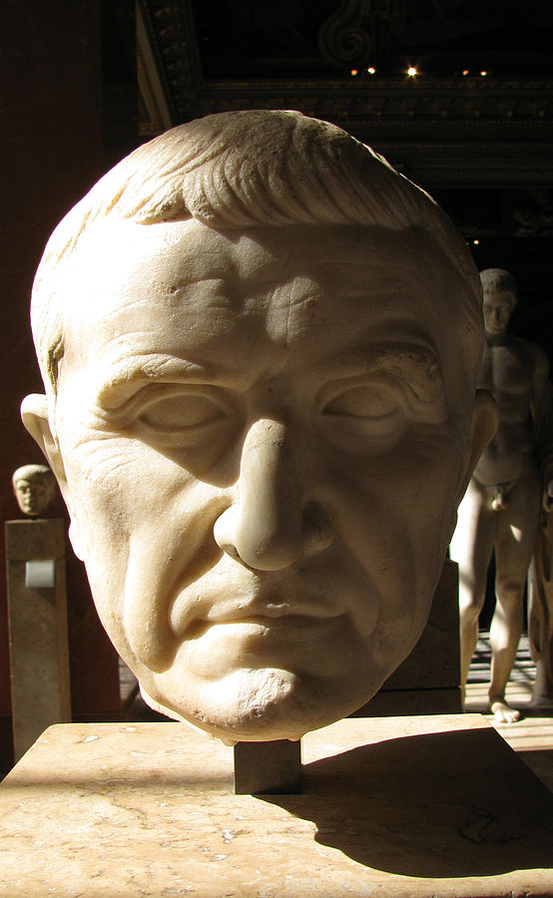
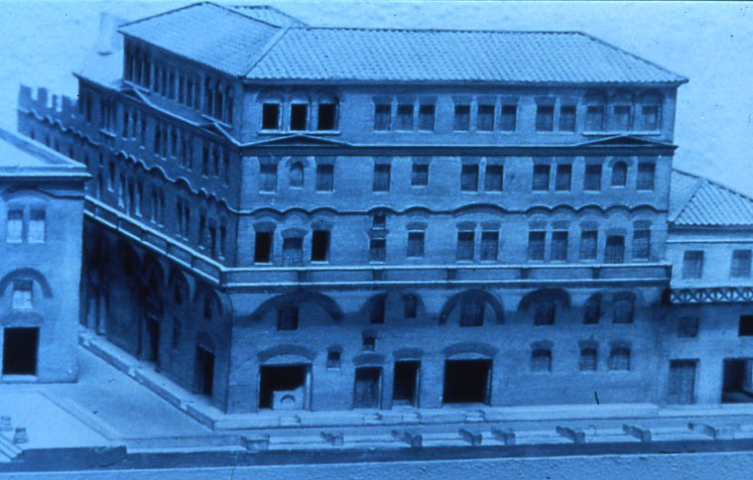
Insulae
Model of a Roman tenement at Ostia
Marcus Licinius Crassus (c. 115-53 BCE)

Slide 32
Key Terms
Comitium
Rostra
Curia
Via Sacra
Temple of Jupiter Optimus Maximus
Centuriation
Decumanus
Kardo
Luna
Paestum
Cosa
Atrium
Triclinium
Villa
Insula
Marcus Licinius Crassus

